Slide 1
Data Science: a Recent Graduate’s ‘Reverse Engineered’ Perspective
Kelsey Warsinske
JSM 2018

Slide 2
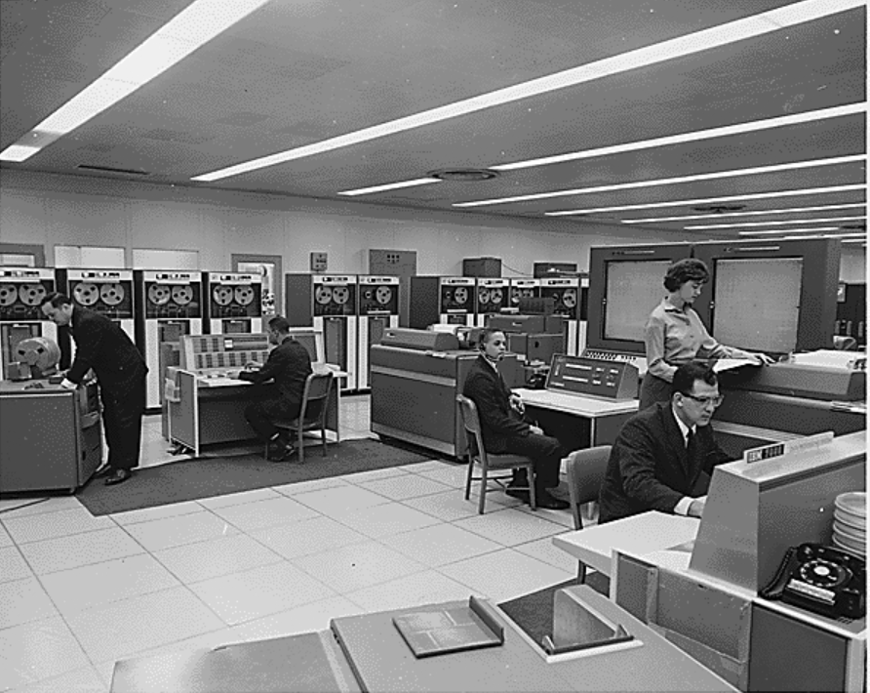

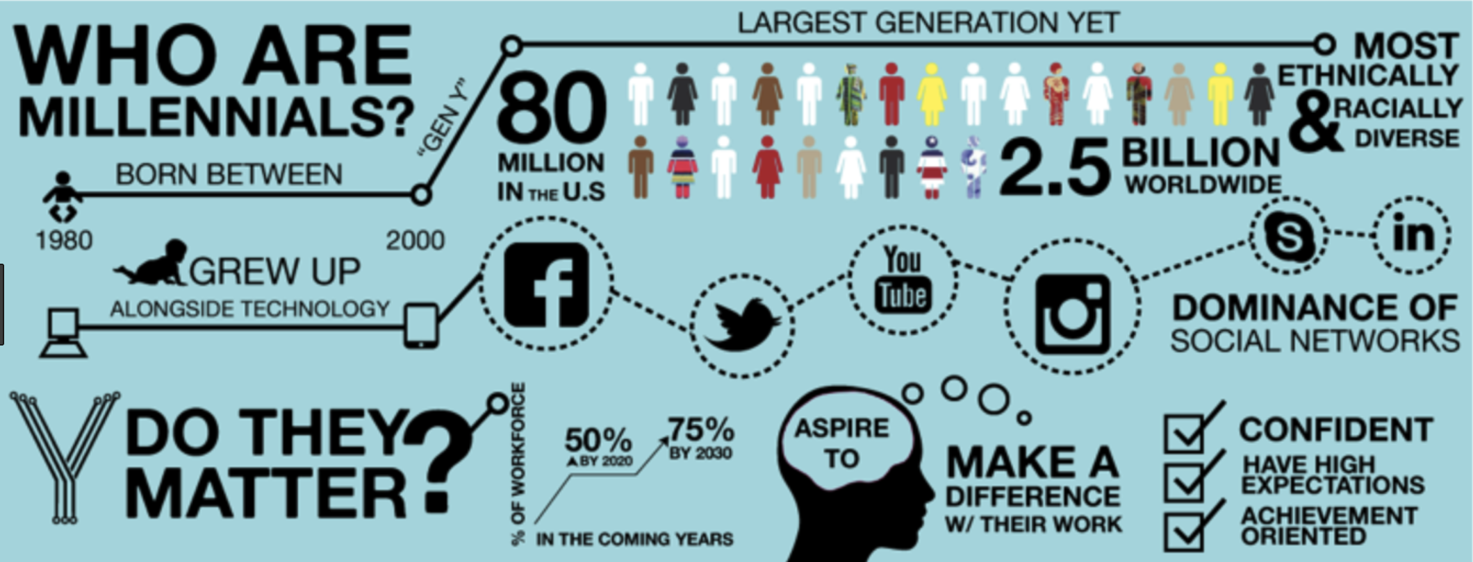
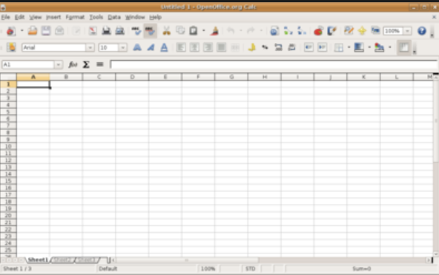
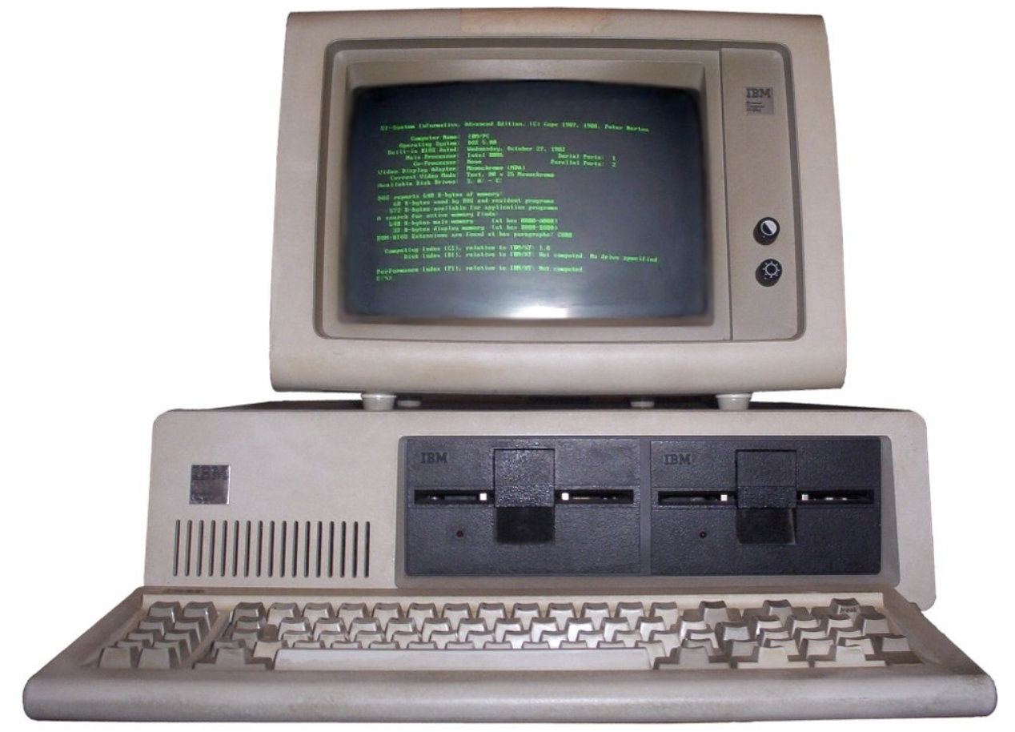
44 ZB of data
90% of the world’s data created in the last 2 years
Mainframe!
$16.5Bil
Millennial Generation
big data market is expected to increase 5x from 2010 to in 2015
4.4 ZB of data
$3.2Bil
1980?
Late 1980s
2000
2020
http://dataconomy.com/2014/07/the-history-of-bi-the-1980s-and-90s/
https://analyticsweek.com/content/big-data-facts/

Slide 3
“We are currently preparing students for jobs that don’t yet exist, using technologies that haven’t been invented, in order to solve problems we don’t even know are problems yet.”
-Richard Riley

Slide 4
What can educators and universities do to prepare students to work in an undefined field?
What can students and new grads (and anyone) do who may be interested in a career as a data scientist?
How does data science make technology do its hired job better?
What’s next in data science (other than we don’t really know)?

Slide 5
What can educators and universities do to prepare students to work in an undefined field?
Application! Application! Application!
Real-world experience and examples
Open source technologies
Data science is as much Statistics as it is software engineering

Slide 6
What can students and new grads (and anyone) do who may be interested in a career in data science?
Get experience!
Don’t think something isn’t possible

Slide 7
How can technology better serve us?

Slide 8
What’s next in data science?
Monetization?
Automation
New platforms and channels
Story telling

